Slide 1
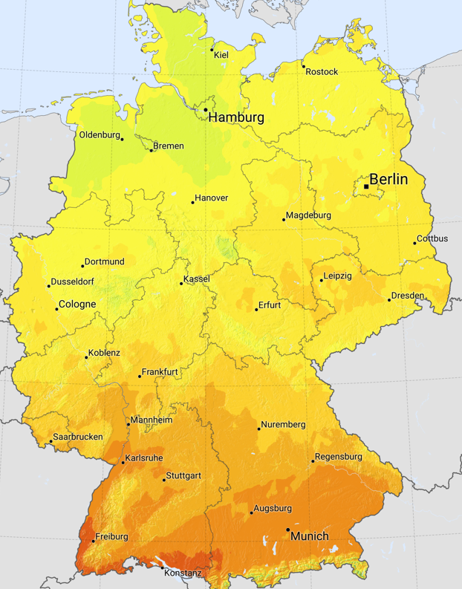

Irradiation in Germany
Solar
It therefore makes sense to build out solar farms in the south
States with largest installed Onshore capacities:
Bavaria (Bayern): ~24.5 GW
Lower Saxony (Niedersachsen): ~12.5 GW
North Rhine-Westphalia (Nordrhein-Westfalen): ~9.98 GW
As of end-2024, Germany had approximately 99 GW of installed solar capacity.
source
Fun Facts:
In April 2025, solar produced more electricity than any other source in Germany
By 2030, Germany’s solar power capacity is set to reach around 215 GW — surpassing all other energy sources and making solar the nation’s number one in installed capacity.

Slide 2
Steadily rising forecasted solar generation due to expanding PV capacity.
Signals stronger grid integration of solar power.
Avg. annual solar growth (2019–2024): ~7.5%
Solar generation peaks from May to August, driven by longer daylight hours and higher solar irradiance.
Output drops sharply in winter months, reflecting Germany’s lower sun angle and shorter days.
Gaussian-like yearly solar pattern (base ≈ 4) can be modeled as a triangle
Gradient Jan–Jul: +1.33 GW/month
Gradient Jul–Dec: −1.6 GW/month

Slide 3
Date: 25.06.2024 Total energy generated: 1667.5 GWh
Context: Summer day, 2024 — year with the highest installed solar capacity in our 6-year timeframe
Daily solar generation follows a normal-like distribution
Peak output occurs around noon (≈12:00) when solar irradiance is highest
Date: 13.01.2019 Total energy generated: 19.4 GWh
Context: Winter day, 2019 — year with the lowest installed solar capacity in our 6-year timeframe
Narrow curve width reflects limited winter solar hours
Low peak results from reduced sunlight and lower installed capacity (2019)

